Slide 1






Hello!
SOC Summer Workshop

Slide 2

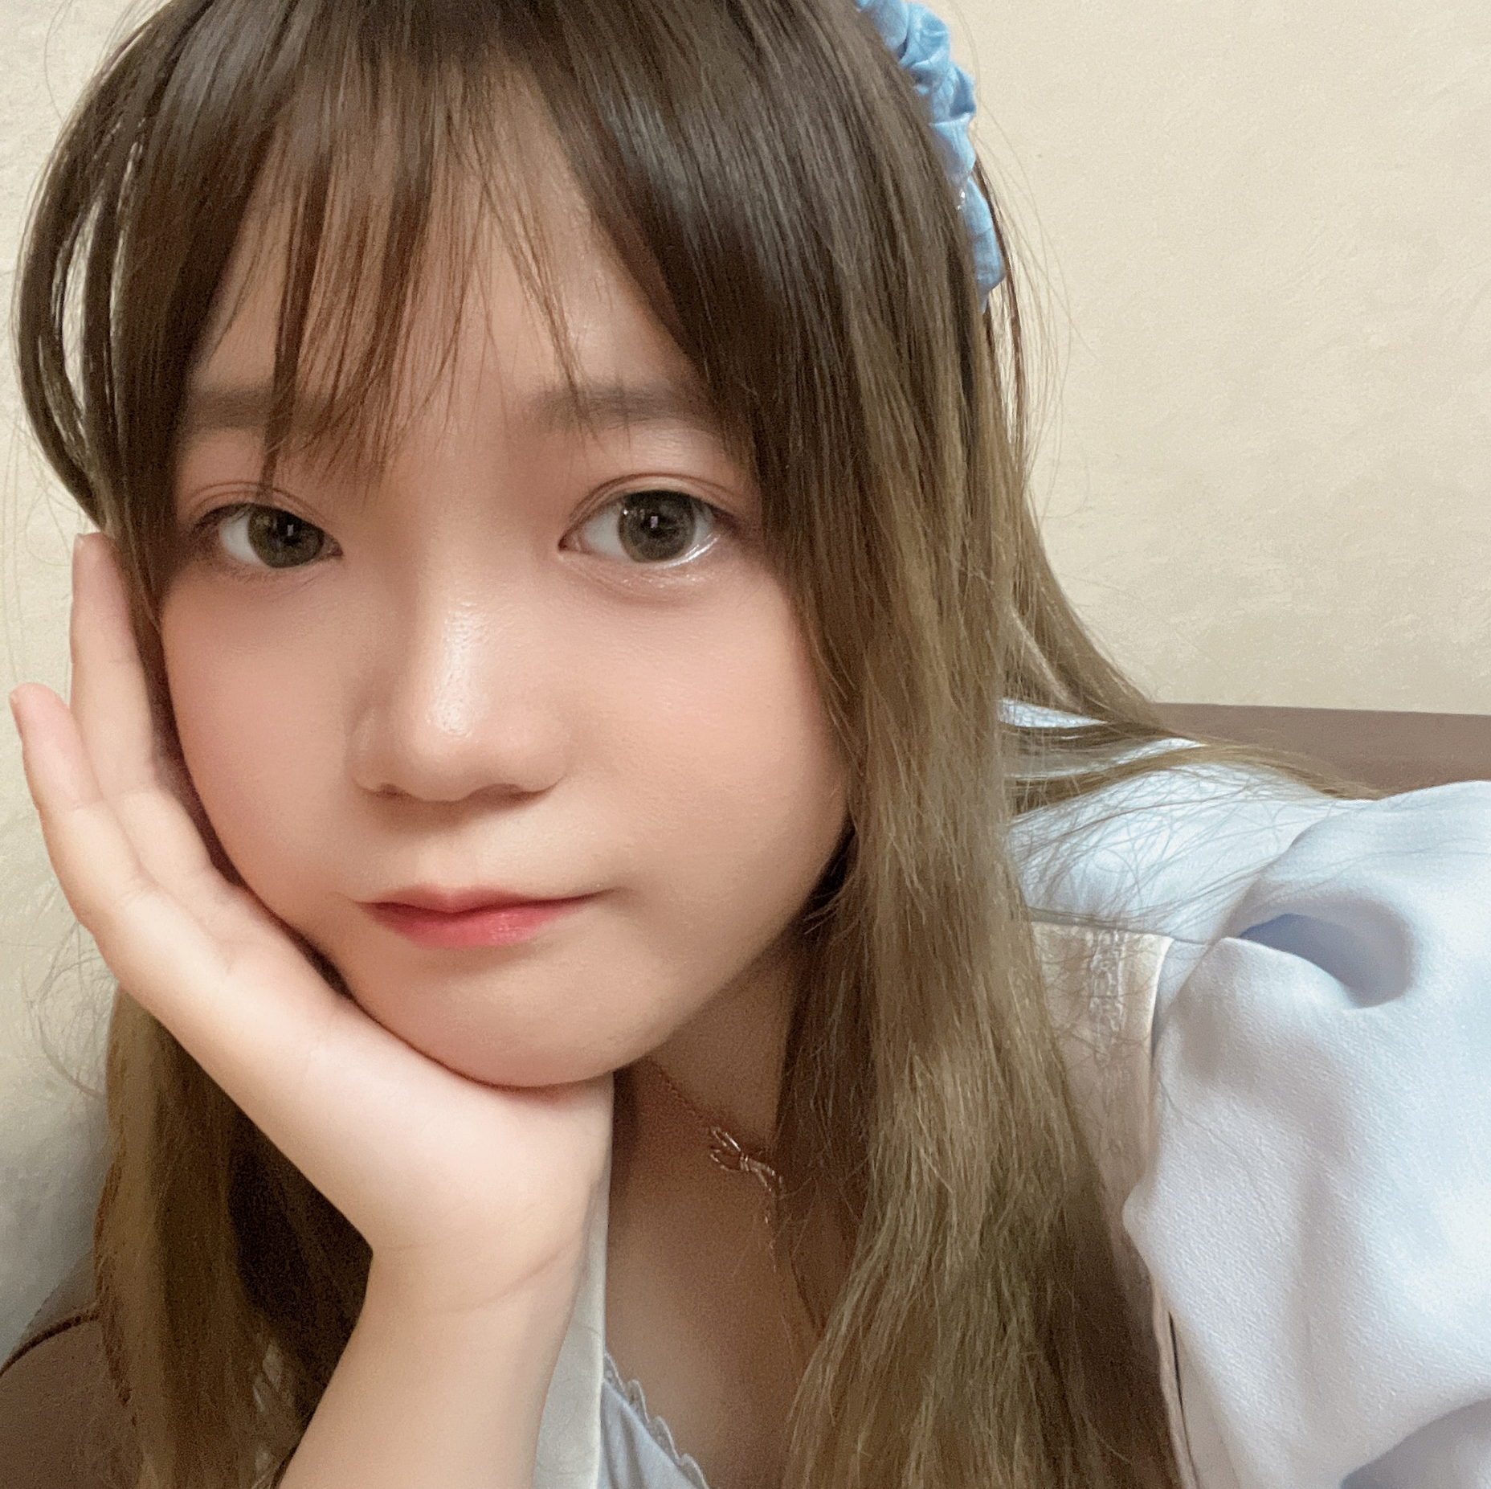

What about me?
Joy Chen(陈怡伽)
Birthday: July 9th
School: East China Normal University(华东师范大学)
Major: Software Engineering​
Location: Chengdu, Sichuan

Slide 3











I love playing games!

Slide 4
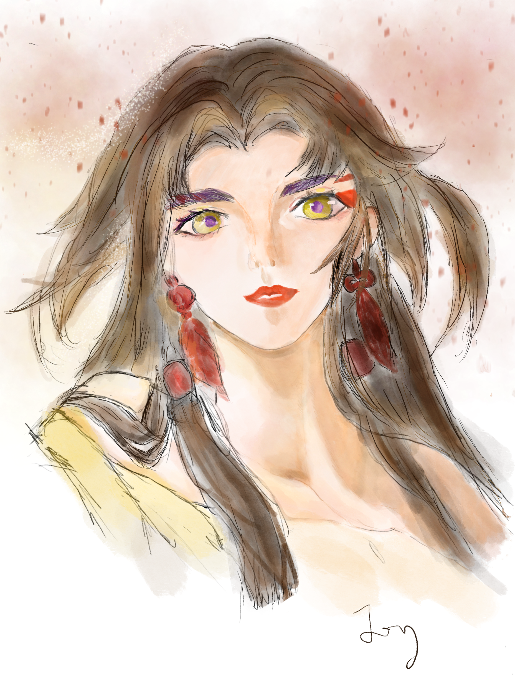

My strength
Data Structure
Algorithm
Operating Systems
C, C++
Python, JavaScript
Java, C#
Passionate
Good at teamwork
Hard-working
Self-study ability
Love drawing
Love designing

Slide 5
Looking forward to…
My lovely teammates.❤
Eager to
learn
Easy-going
Good at programming
Good teamwork
Creative
Process
focus

Slide 6



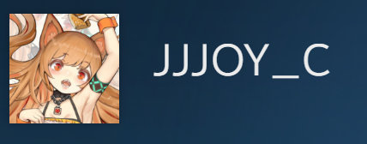
Twitter:
@JoyCC0709
WeChat:
ccchen079
Steam:
1146180235
QQ:
1196056610
Please contact me!

Slide 7
Thank You!
For your attention

